Slide 1
Character
Notes:
Warrior Creed

Slide 2

Building Blocks
Self-Knowledge is the First Step to leadership
Know what you do not like
What you do like
Awareness about self is learned through experience
Notes:
Googins

Slide 3
What’s Your End game?
A leader is a person with purpose where are efforts directed
You Link goals to purpose
Leaders “Keep the main thing the Main thing”

Slide 4
Ask Yourself Tough Questions
How do you want to be remembered?
What will people say when your gone.
What would the people that are closest to you in life say about you

Slide 5

Ask questions to yourself…
Who you are?
What am I about?
What you do you stand for?
Where is my spark?
What is my life worth?

Slide 6
Recognition
Give credit where credit is due
If you did it take the credit
If you had help, recognize those that helped you
Leaders recognize you get results through the help of others

Slide 7

Leaders Are Made Not Born
Leaders have no patience for the small hurts that are bothering themselves or their teammates.
Learning how to perform at that the highest level means any small hurts will have to be pushed aside.
Working/Performing through the small hurts is expected on high performing teams.
Learn how to perform with small hurts.
Notes:
Lombardi
Googins

Slide 8

Leaders Live in the Present
Learn from your defeats or setbacks and apply that knowledge to your present situation
Notes:
Lombardi

Slide 9

Build Your Character
No backstabbing, leaders don’t put others down
Character effects all aspects of life
Notes:
Lombardi

Slide 10
Building Character
Awareness self knowledge
Character means Engrave and inscribed
Who you are written engraved inscribed
Unchanging Principles
Solid
Learned from our heroes and roll models
Notes:
Lombardi

Slide 11
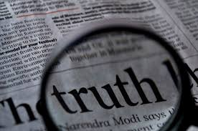
Building Character Seeking Truth
Leaders must be both analytical and skeptical where is the truth involved.
Do not parcel out the truth on a need to know basis
Notes:
Lombardi

Slide 12
Seeking Truth
Always show respect and have compassion for others
Always seek the truth
Be grounded in truth
Trust a Pillar of Character
No Truth = No Trust
You Cannot Lead People without Trust
Notes:
Lombardi

Slide 13

A solid leader is a person that is grounded in truth
Notes:
Lombardi

Slide 14

Build Character – Be Authentic
Authenticity is Another Word for Integrity.
If you think you can deceive people you are wrong, people will always see through it.
Notes:
Lombardi
Goggins

Slide 15
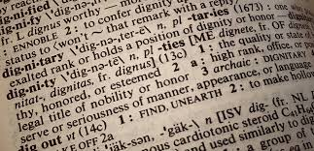

Build a Climate/Culture
Reflect a climate of openness, dignity and respect to all people on your team and in the business
Notes:
Lombardi

Slide 16

Your Word is Your Bond
Leaders are Accountable
Leaders are the same in public as in private
Notes:
Warrior Creed

Slide 17

Earn your Stripes
Get Results
Show you can Lead
Notes:
Lombardi

Slide 18

Think Big Picture
The big picture is your roadmap and rudder
It cannot change in response to minor setbacks
Must change as the competitive environment changes
Notes:
Lombardi

Slide 19

Emotional Maturity
Determine you existing strengths and build upon them
The Roots of maturity are effective priority setting and good decision making
When your immature emotionally you will exaggerate what is not important

Slide 20

Act Don’t React
Reflect upon your past experiences so you don’t make the same mistakes repeatedly.
Study the past to discover the truth
Relying on past experience may not work in the present situations
Notes:
Lombardi

Slide 21

Be Prepared to Sacrifice
Sacrifice lies behind every success
The small hurts… learn to live with them
Selfness
Notes:
Lombardi

Slide 22
Qualities All Leaders Can Develop
Intensity
Singleness of purpose
Total Commitment
Believe in yourself and your successes
Notes:
Lombardi

Slide 23
What Type of Person Are You
Ego must be defeated
Visual prejudice
Race relations
Leadership Colour blindness
Respect everybody on the team
Get problems out in the open

Slide 24

Find Your Own Tools
Warrior Creed
Accountability Mirror
Your Hero’s
Books, Podcasts, Youtube

Slide 25
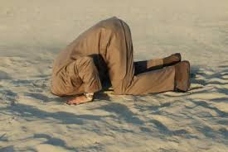
The opposite of Self-Knowledge is ignorance, misconception and misunderstanding
Knowledge is important because the way you see life will be reflected in your communication and interactions with everyone else.
Notes:
Lombardi

Slide 26
The leader is a common person with uncommon desire to succeed.

Slide 27
End Character
Notes:
Warrior Creed

